Slide 1
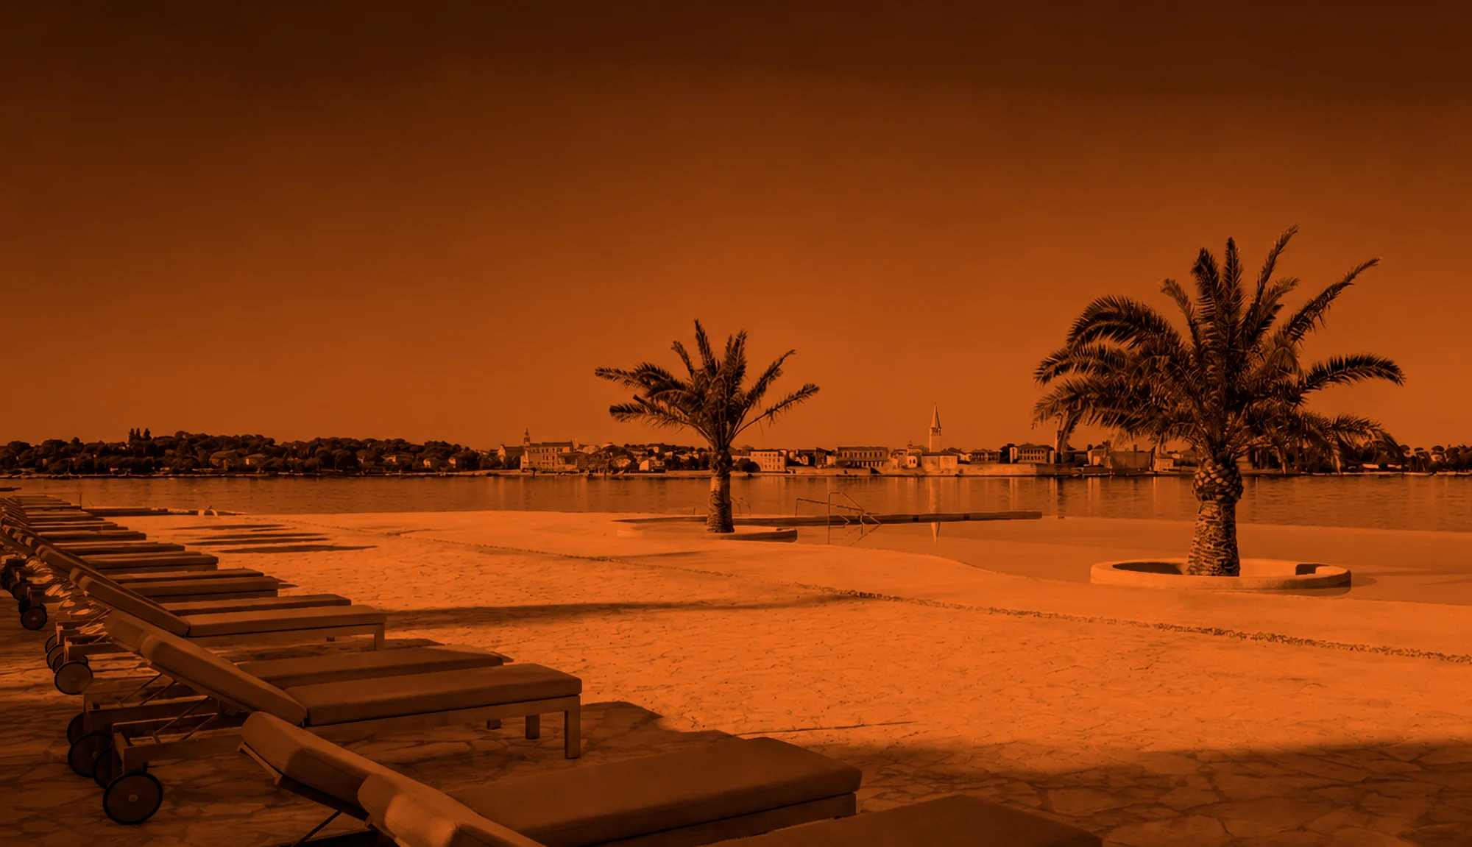


16–19
3
2027
Pical Resort · Poreč — Parenzo · Istria, Croatia
CESTE-CONFERENCE.COM
ORGANISER · PLENORIA
Notes:
Naslovni slide konferencije — autori ga ostavljaju nepromijenjenim.

Slide 2
ARTICLE
TITLE OF THE PAPER
Author name, title
University / Institute / Company
Co-author name, title
University / Institute / Company
51ST INTERNATIONAL ROAD CONFERENCE & EXPO
POREČ · 16–19 MARCH 2027
Notes:
Autor upisuje naslov rada, ime i instituciju.

Slide 3
CONTENTS
01
Introduction
02
Second chapter
03
Third chapter
04
Fourth chapter
05
Conclusion
51ST INTERNATIONAL ROAD CONFERENCE & EXPO
POREČ · 16–19 MARCH 2027
Notes:
Sadržaj izlaganja — 5 poglavlja, autor ih preimenuje.

Slide 4
SECTION TITLE
01
First key point of this section
Second key point, kept to a single line where possible
Third key point
51ST INTERNATIONAL ROAD CONFERENCE & EXPO
POREČ · 16–19 MARCH 2027
Notes:
Prazan slide za sadržaj izlaganja — autor ga duplicira po potrebi.

Slide 5
REMARKS
01
The presentation must be in Croatian, English or Serbian.
02
The oral presentation is limited to 10 minutes.
03
Keep the first and the last slide of this template unchanged.
INFO@CESTE-CONFERENCE.COM
Notes:
Napomene organizatora autorima.

Slide 6
THANK YOU
Questions and discussion
AUTHOR@EMAIL.COM
CESTE-CONFERENCE.COM
Notes:
Zadnji slide — pitanja i kontakt.

